Slide 1
STATISTICAL ANALYSIS OF BRAIN TUMOR USING UWB ANTENNA BY
ABISHEK BERNALD.G (211714106003)
JEYALAKSHMI.M (211714106054)
KARTHIKA.E (211714106057)
UNDER THE GUIDANCE OF
Mrs. S.VANAJA M.E
ASSISTANT PROFESSOR

Slide 2
INTRODUCTION
Brain tumour is one of the most dangerous diseases that may affect the life of the human.
According to the statistics, 13.2 million deaths of tumour are expected in 2030.
Brain tumour is malignant or benign mass or growth of abnormal cells in the brain.
Magnetic resonance imaging (MRI), it is more dangerous for patients with metallic devices placed inside their body and it is very expensive.
In Computed Tomography (CT) scan there is a risk to patient because of high ionizing radiation dose and it is also very expensive.
Microwave technique mainly concentrate on the dielectric properties between the healthy and defected brain tissues. Also microwave based techniques are fast, cost effective and portable.

Slide 3
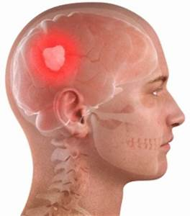
OBJECTIVE
To design and fabricate the UWB antenna for the desired frequency range of 3.67 – 13.2GHz.
To analyse the various statistical parameters from the obtained reflection coefficient value, in order to detect the presence of tumour we model the head phantom with tumour and without tumour.
Skin and layers of head
Tumour
Transmitter antenna
Mutual coupling
Receiver antenna

Slide 4
LITERATURE REVIEW
S.NO | TITLE | YEAR | AUTHOR NAME | JOURNAL NAME | REMARKS
1 | UWB Antenna for Brain stroke and Brain Tumour Detection | 2016 | M.A. Shokry, Prof. Dr.A.M.M.A. Allam | Electromagnetic field computation (IEEE) | There is a good agreement between the measured and simulated results of the return loss of the antenna on human’s head and head phantom. We can only detect the presence of brain tumour with radius 24.6mm and above.

Slide 5
LITERATURE REVIEW
S.NO | TITLE | YEAR | AUTHOR NAME | JOURNAL NAME | REMARKS
2 | A UWB Antenna for Microwave Brain Imaging | 2015 | Adhitya Satria Pratama, Basari*, Muhammad Firdaus S. Lubis, Fitri Yuli Zulkifli, Eko Tjipto Rahardjo | Antennas and Propagation (IEEE) | This antenna is a printed dipole fed by a coplanar waveguide it provides high frequency response The entire desired working frequencies can be covered by adding perturbation on antenna structure.

Slide 6
LITERATURE REVIEW
S.NO | TITLE | YEAR | AUTHOR NAME | JOURNAL NAME | DEMERITS
3 | Optimization of UWB Vivaldi Antenna for Tumour Detection | 2013 | Mohammed A. Alzabidi, Maged A. Aldhaeebi and Ibrahim Elshafiey | Artificial Intelligence, Modelling & Simulation (IEEE) | The antenna is immersed in background of relative permittivity 40 to achieve good matching with the head tissue. Results show that good performance is obtained. With the increase of frequency of operation, the resolution is enhanced, while the energy penetration is reduced. There is thus a trade-off between these two.

Slide 7
LITERATURE REVIEW
S.NO | TITLE | YEAR | AUTHOR NAME | JOURNAL NAME | REMARKS
4 | Microwave Imaging for Brain Tumour Detection Using an UWB Vivaldi Antenna Array November | 2012 | Haoyu Zhang, Brian Flynn, Ahmet T. Erdogan, Tughrul Arslan | Loughborough Antennas & Propagation (IEEE) | The impulse intensity is employed to represent the tumour location since the antenna array rotates 1.5° for each step which offers enough precision for image processing. Antenna array rotates far away from the tumour, only a few sets of data can be collected since the tumour reflections are very weak around there.

Slide 8
LITERATURE REVIEW
S.NO | TITLE | YEAR | AUTHOR NAME | JOURNAL NAME | REMARKS
5 | A Smart Antenna Array for Brain Cancer Detection | 2011 | Haoyu Zhang, Ahmed O. El-Rayis, Nakul Haridas, Nurul H. Noordin, Ahmet T. Erdogan, Tughrul Arslan | Loughborough Antennas & Propagation (IEEE) | The antenna array is composed of three ultra-wideband Vivaldi antennas which have relatively small dimensions and provide good performance. The response of brain with tumor and without tumour have similar profile only amplitude of brain with tumour is slightly greater than others.

Slide 9
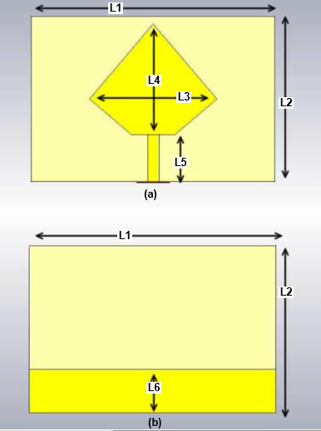
EXISTING MODEL
An UWB Pentagon antenna is designed to detect brain stroke and brain tumour. It is operating at a band from 3.3568-12.604 GHz in free space and from 3.818 to 9.16 GHz on the normal head model.
The head phantom with conductivity and permittivity as that of the human head was analysed by the signal transmitted and received from the antenna.

Slide 10
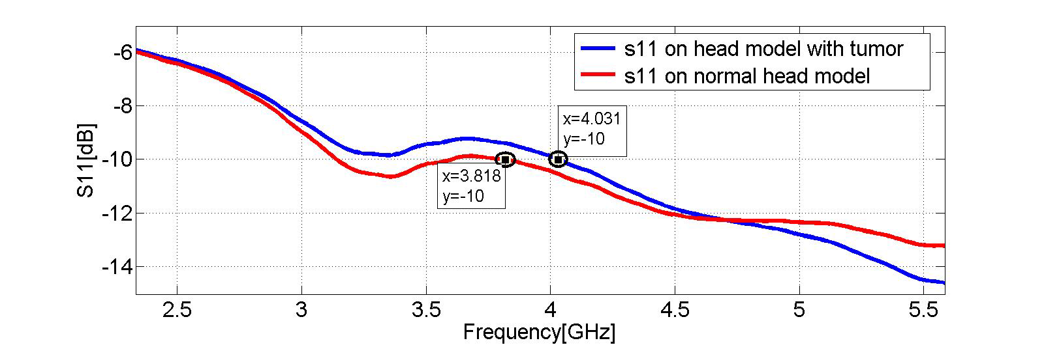
EXISTING MODEL
Presence of tumour can be detected by the frequency shifting in return loss response curve of head model with and without tumour.

Slide 11
PROPOSED MODEL
A modified UWB Pentagon antenna, was designed and simulated on the CST Microwave Studio.
The free space testing was done with the designed antenna and its Reflection coefficient, gain, directivity values were measured.
Then an head phantom model which is having the conductivity and permittivity same as that of the human’s head was designed.

Slide 12
PROPOSED MODEL-CONT...
Head phantom model with and without tumor was designed and simulated.
Signals were received by the antenna, the tumor cells produce higher amount reflections than the normal tissue.
From the reflection coefficient values, the statistical parameters like mean, variance etc.. were calculated.
The presence of tumor was detected with the various statistical analysis.

Slide 13
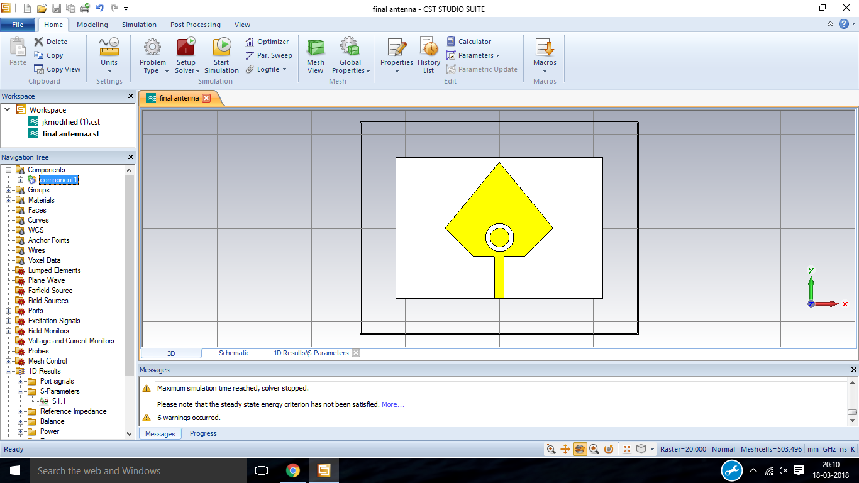
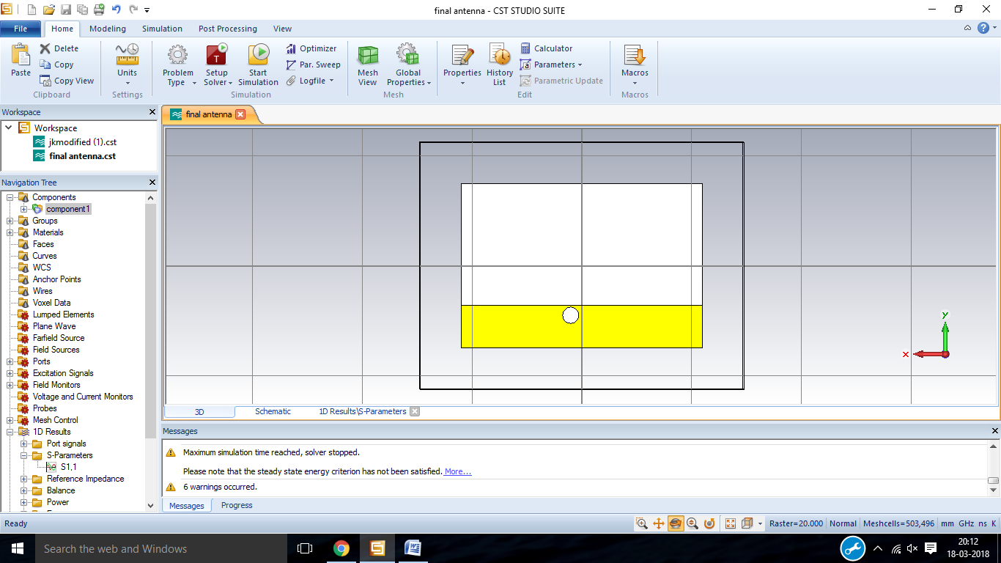
DESIGNED MODEL
In order to increase the bandwidth and directivity of the antenna various modifications are done in the patch and ground.
Front view
Back view

Slide 14
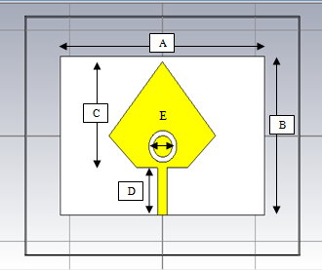
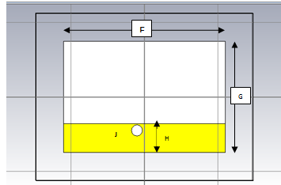
ANTENNA DIMENSIONS
dimensions | Length in mm
A | 44
B | 30
C | 20
D | 8.58
E | 2(radius)
dimensions | Length in mm
F | 44
G | 30
H | 7.8
J | 1.5(radius)

Slide 15
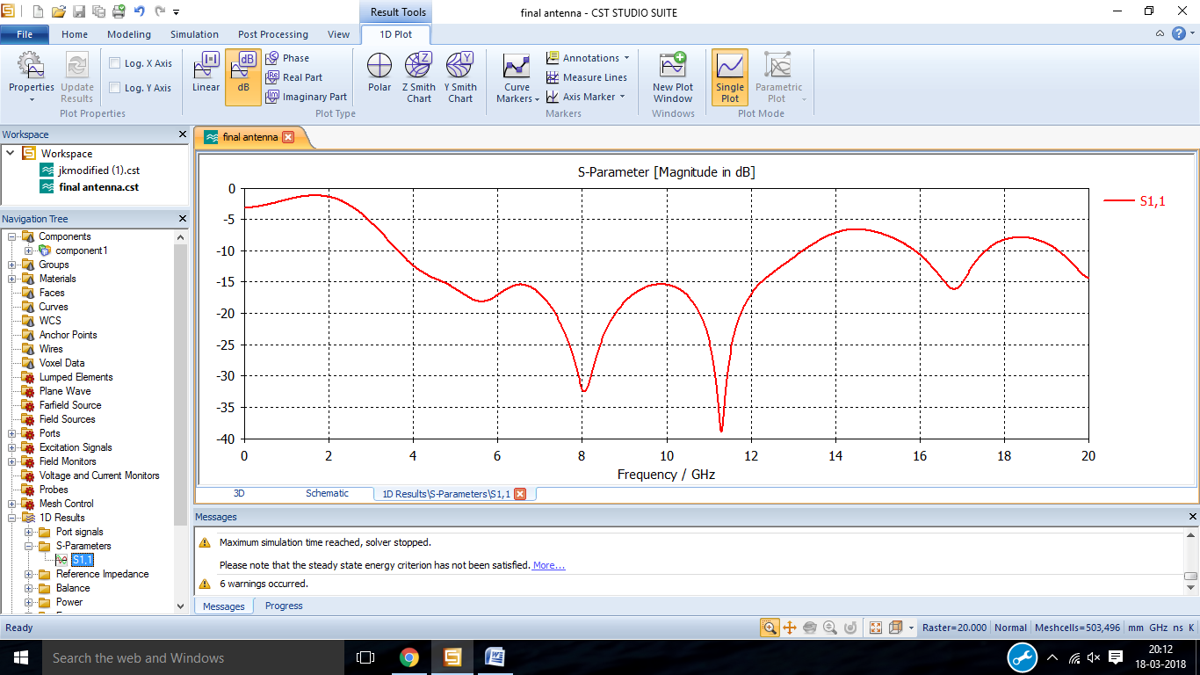
REFLECTION COEFFICIENT S11 OF DESIGNED ANTENNA
The reflection coefficient curve of the designed antenna.

Slide 16
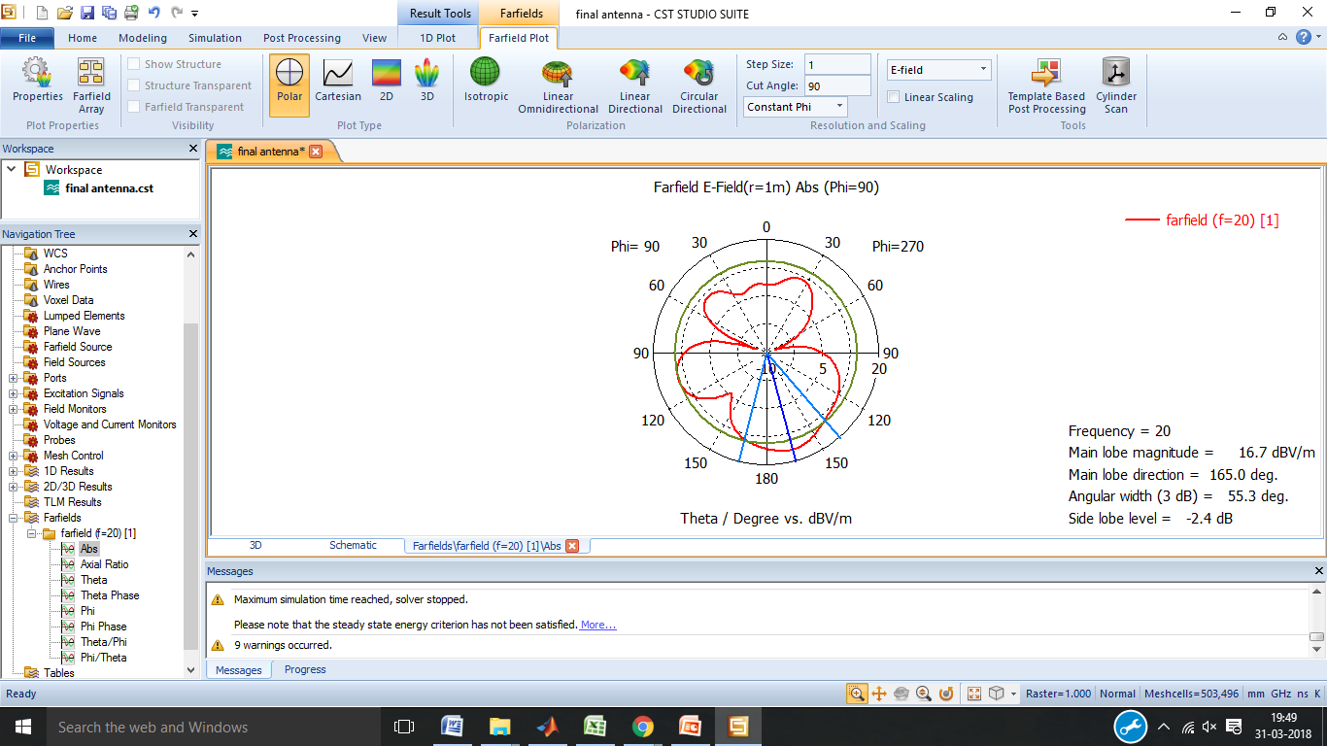
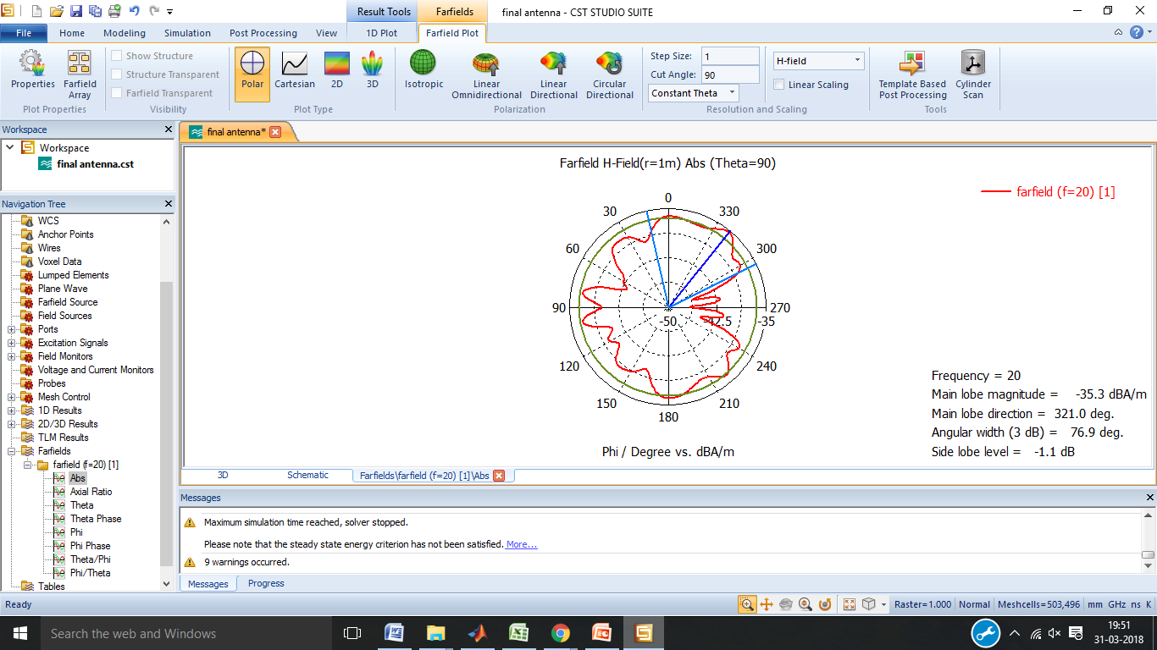
E-FIELD AND H-FIELD PATTERN
The E-Field and H-field pattern of the designed antenna is shown below.

Slide 17
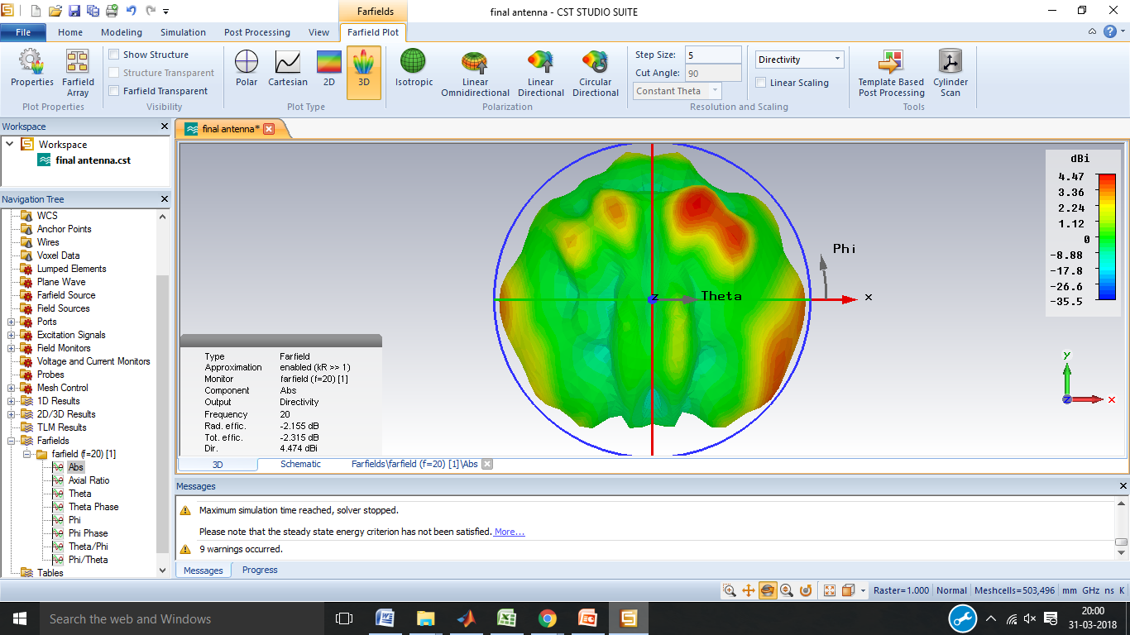
RADIATION PATTERN OF DESIGNED ANTENNA
The radiation pattern of the designed antenna in free space. Its directivity is 4.47 dB.

Slide 18
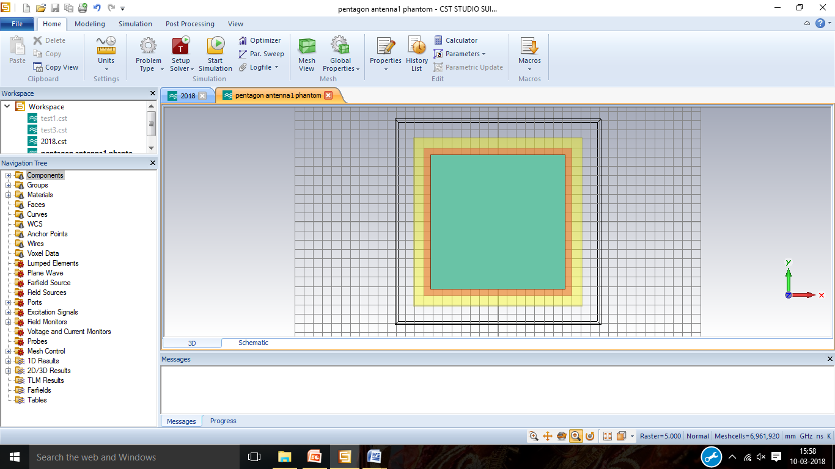
PHANTOM DESIGN
The phantom was designed which has the permittivity and conductivity which is same as that of the human head. Different layers were generated such as skin, skull and brain. This is the model which shows the phantom with out tumour.

Slide 19
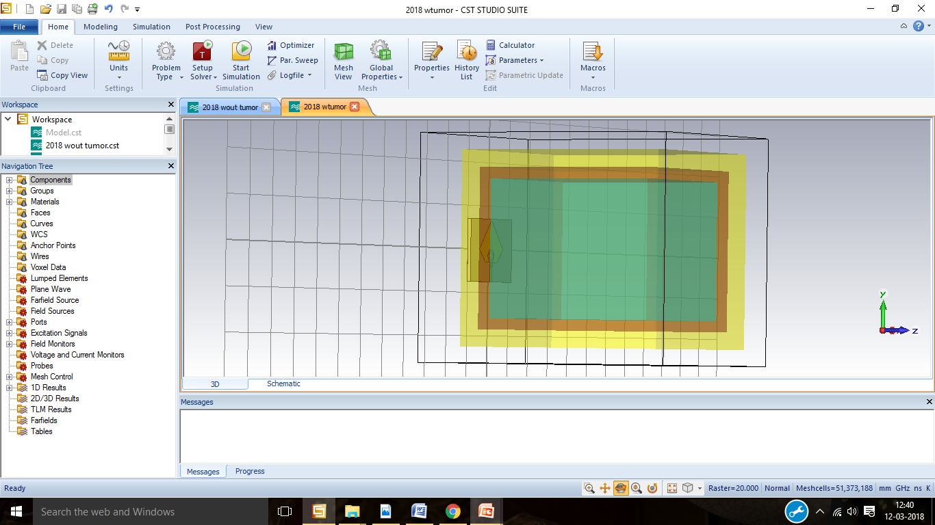
PHANTOM DESIGN WITHOUT TUMOR
 | ELECTRIC PERMITTIVITY | ELECTRIC CONDUCTIVITY
BRAIN | 49.7 | 0.59
SKULL | 17.8 | 0.16
SKIN | 46.7 | 0.69

Slide 20
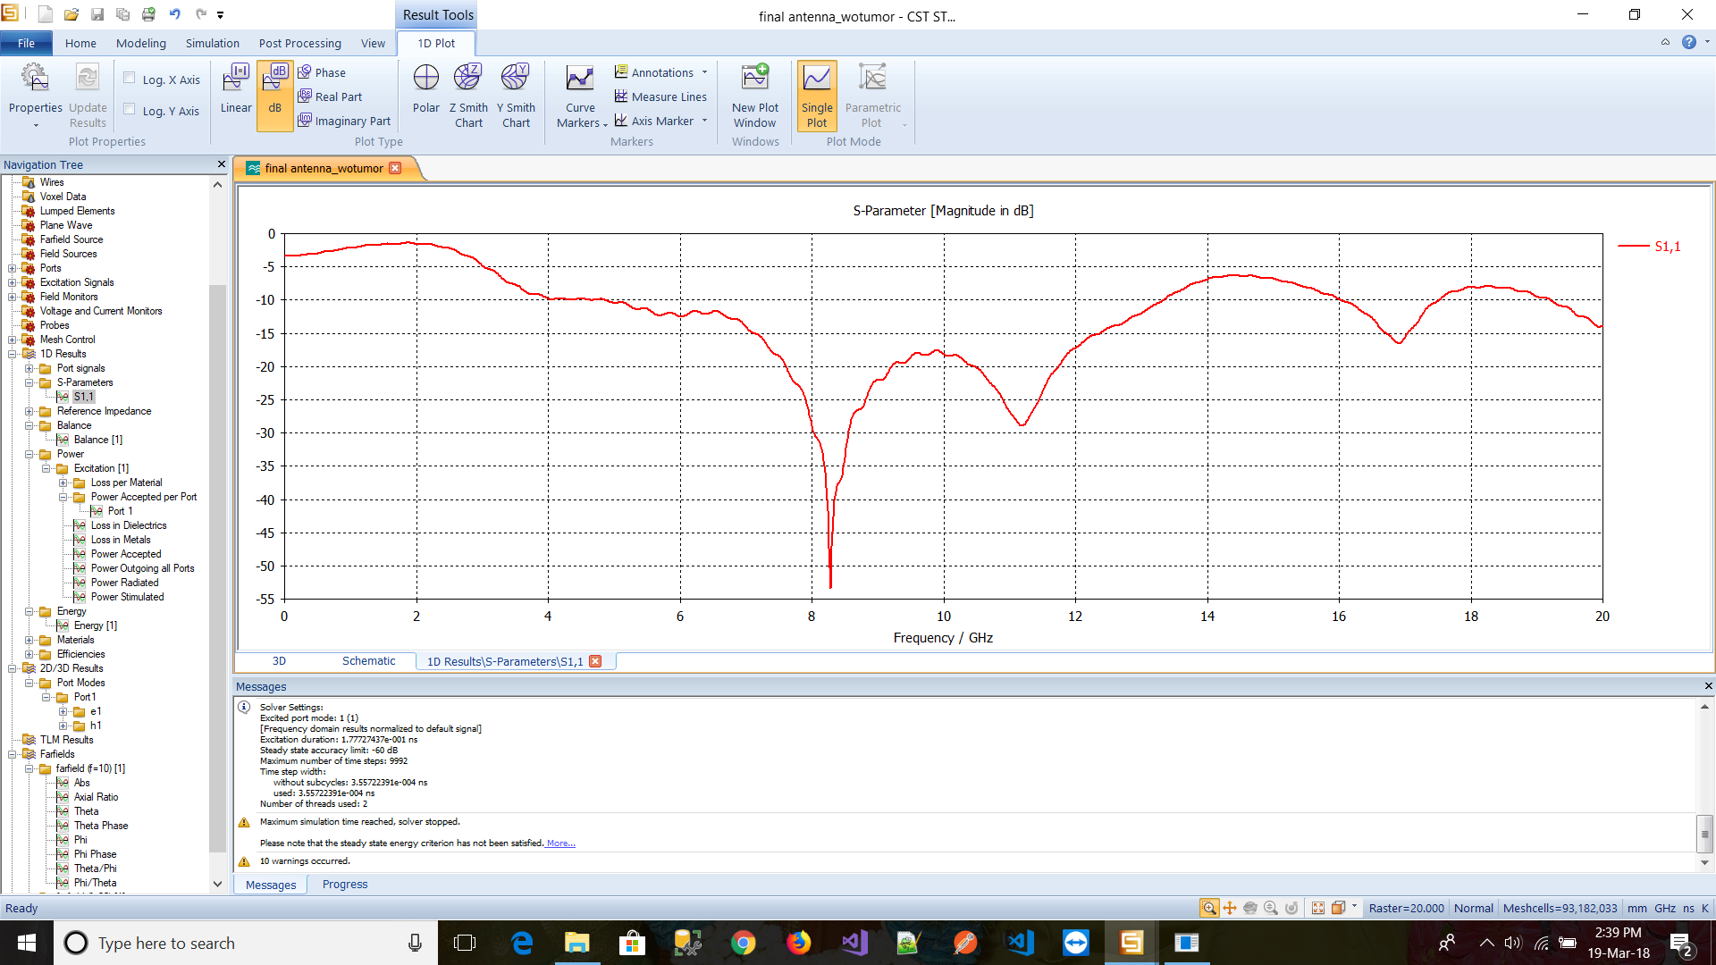
REFLECTION COEFFICIENT S11 OF HEAD MODEL WITHOUT TUMOR
Above figure shows the reflection coefficient S11 of the head model without tumour.

Slide 21
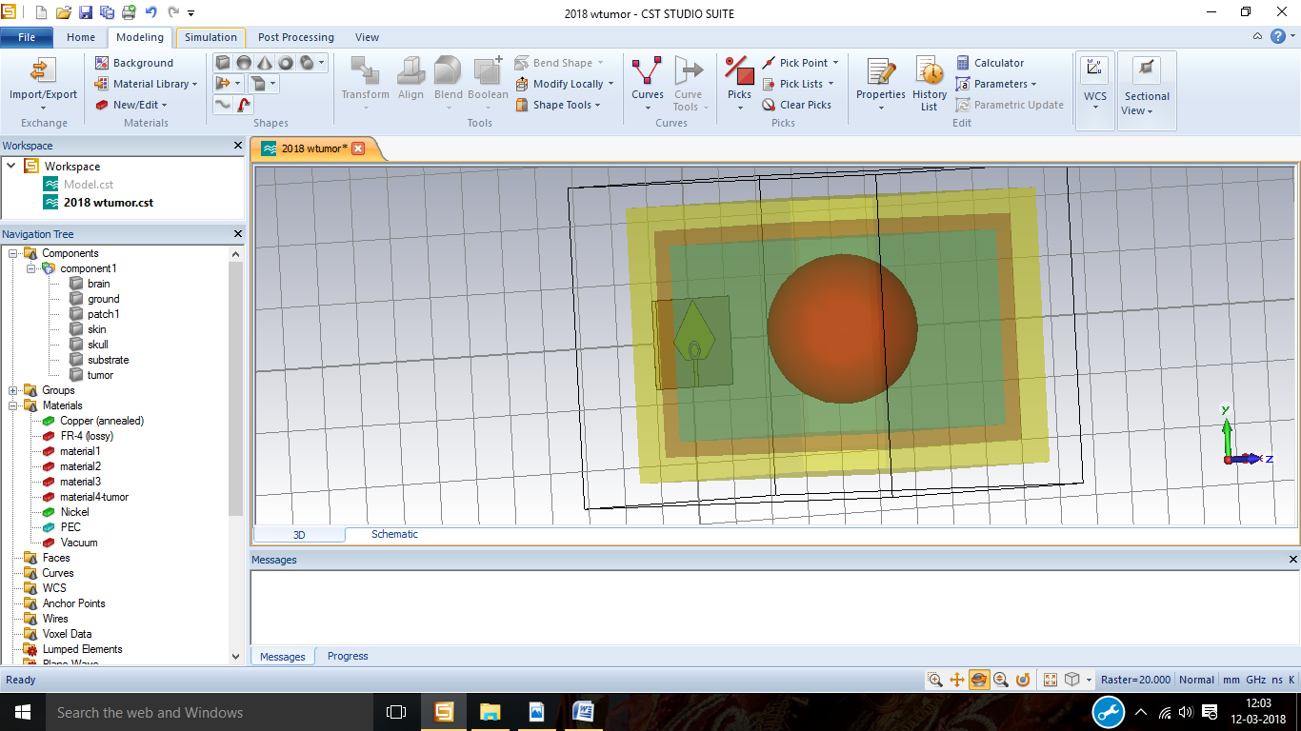
PHANTOM DESIGN WITH TUMOR
This is the head phantom model with different layers and a tumour. Spherical shaped tumour with radius 24.6mm.

Slide 22
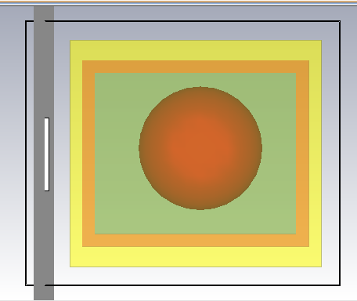
TUMOUR1
A Spherical shaped tumour which is present inside the brain with 24.6 mm radius having the electrical permittivity of 70.

Slide 23
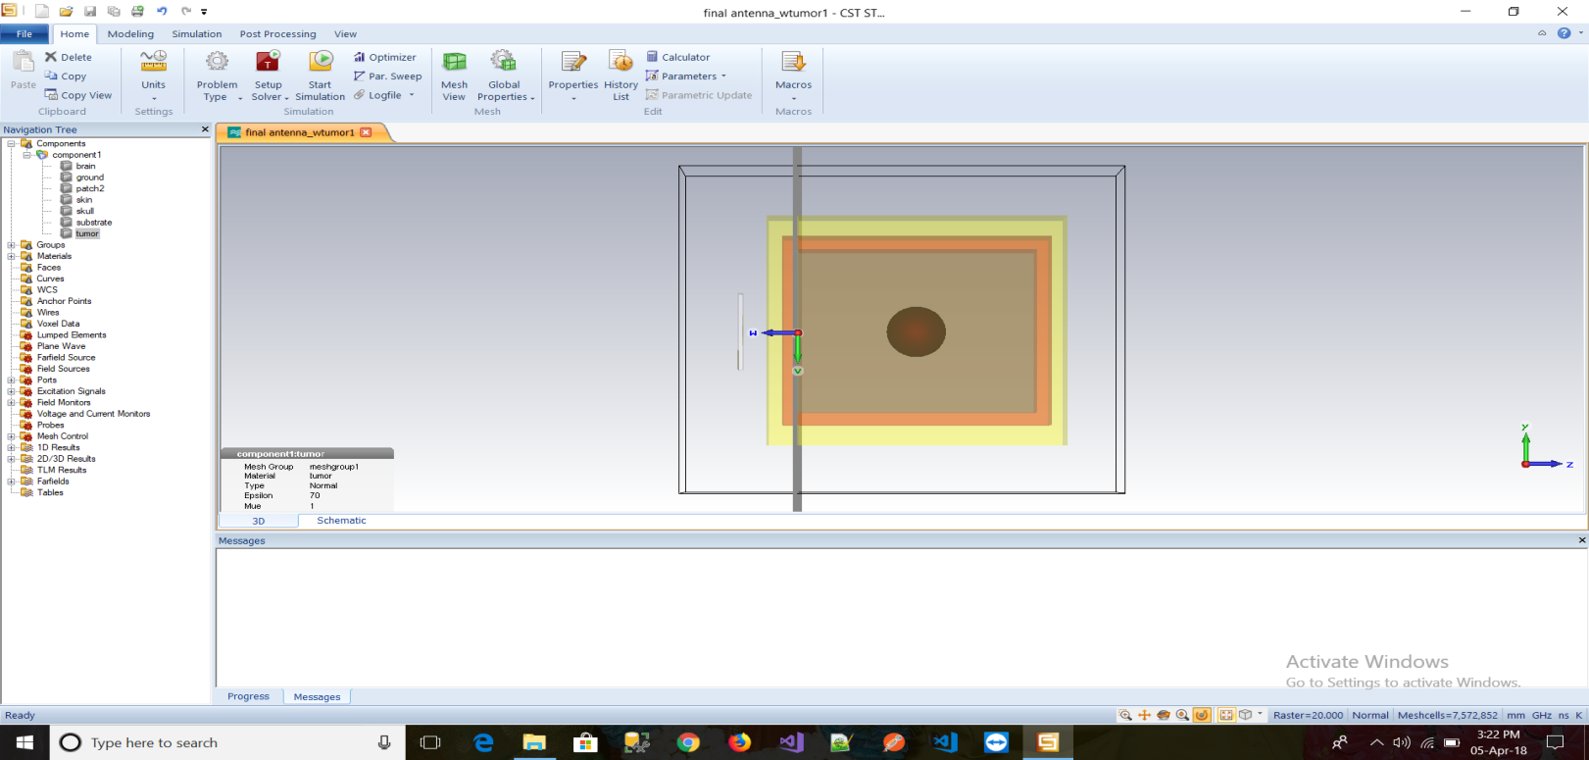
TUMOUR2
The head model containing 10mm tumour which is at a distance of 40mm from antenna.

Slide 24
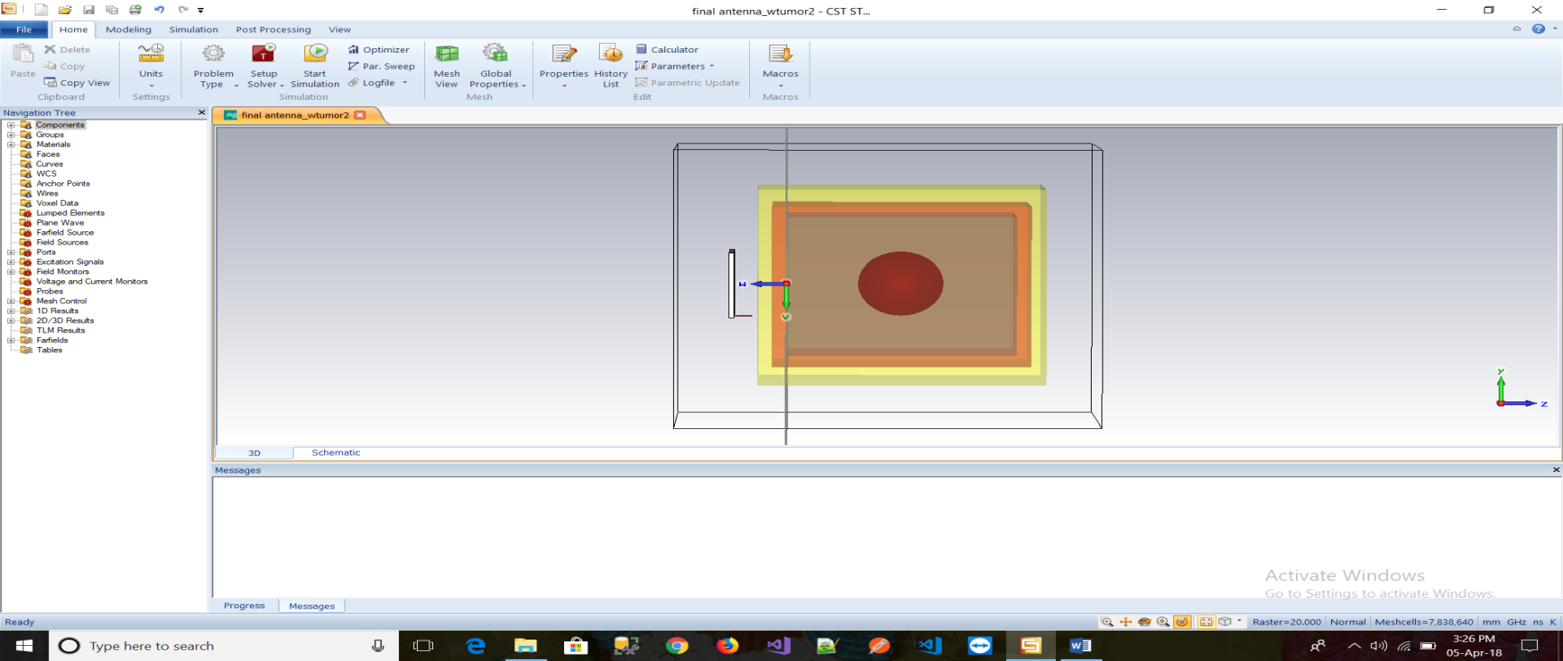
TUMOUR3
The head model containing 15mm tumour which is at a distance of 40mm from antenna.

Slide 25

TUMOUR4
The head model containing 24.6mm tumour which is at a distance of 30mm from antenna.

Slide 26
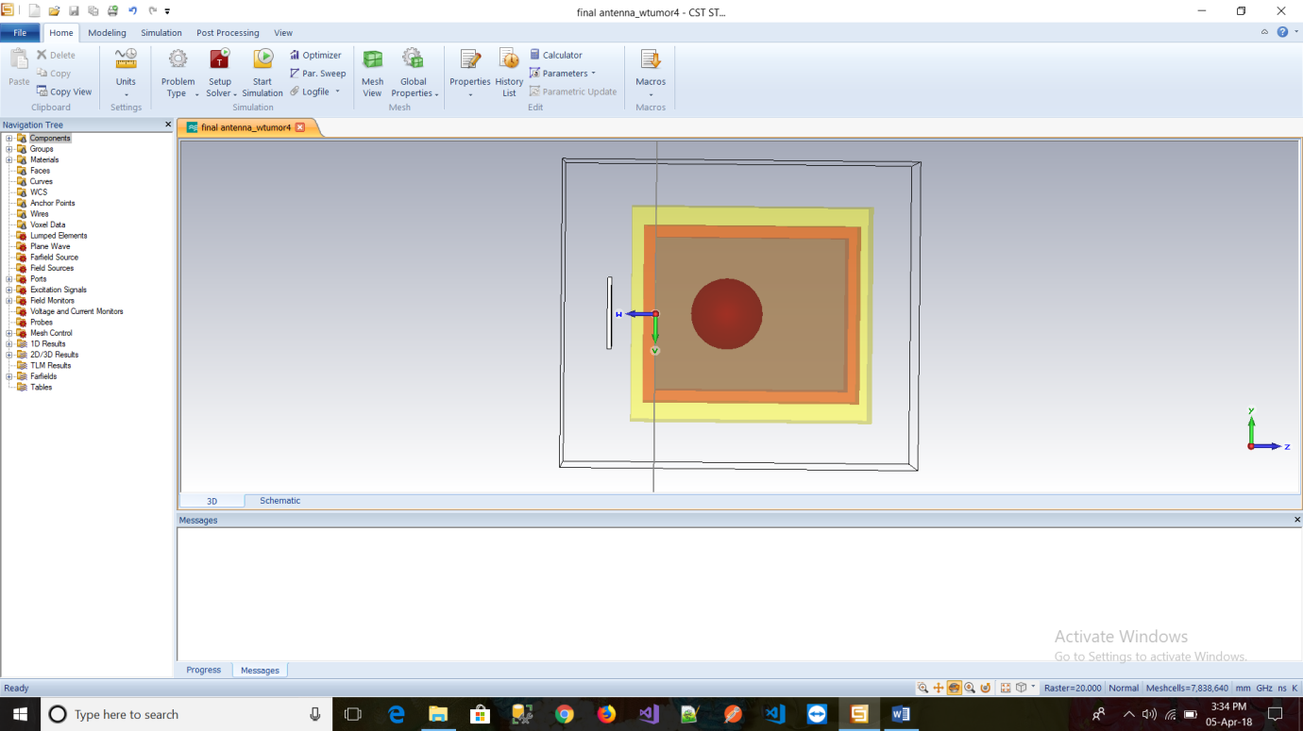
TUMOUR5
The head model containing 15mm tumour which is at a distance of 30mm from antenna.

Slide 27
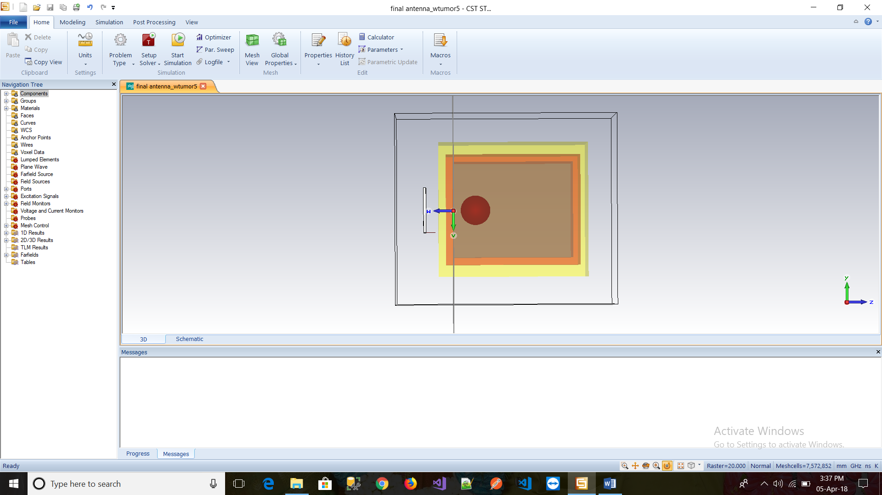
TUMOUR6
The head model containing 10mm tumour which is at a distance of 15mm from antenna.

Slide 28
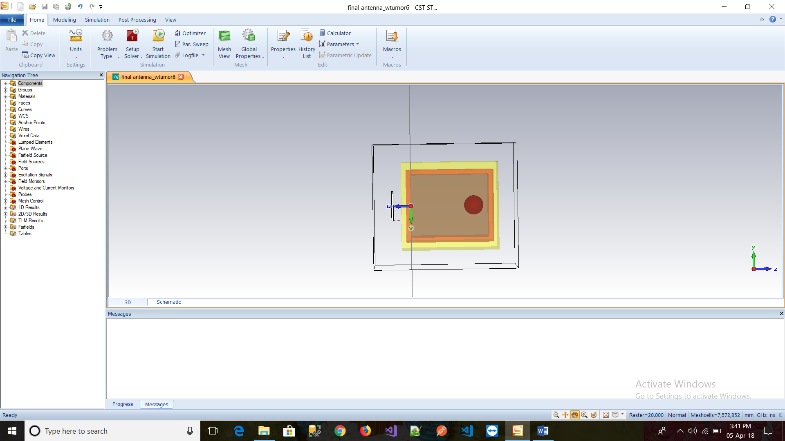
TUMOUR7
The head model containing 10mm tumour which is at a distance of 65mm from antenna.

Slide 29
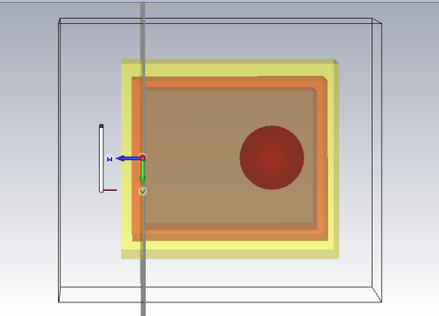
TUMOUR8
The head model containing 15mm tumour which is at a distance of 60mm from antenna.

Slide 30
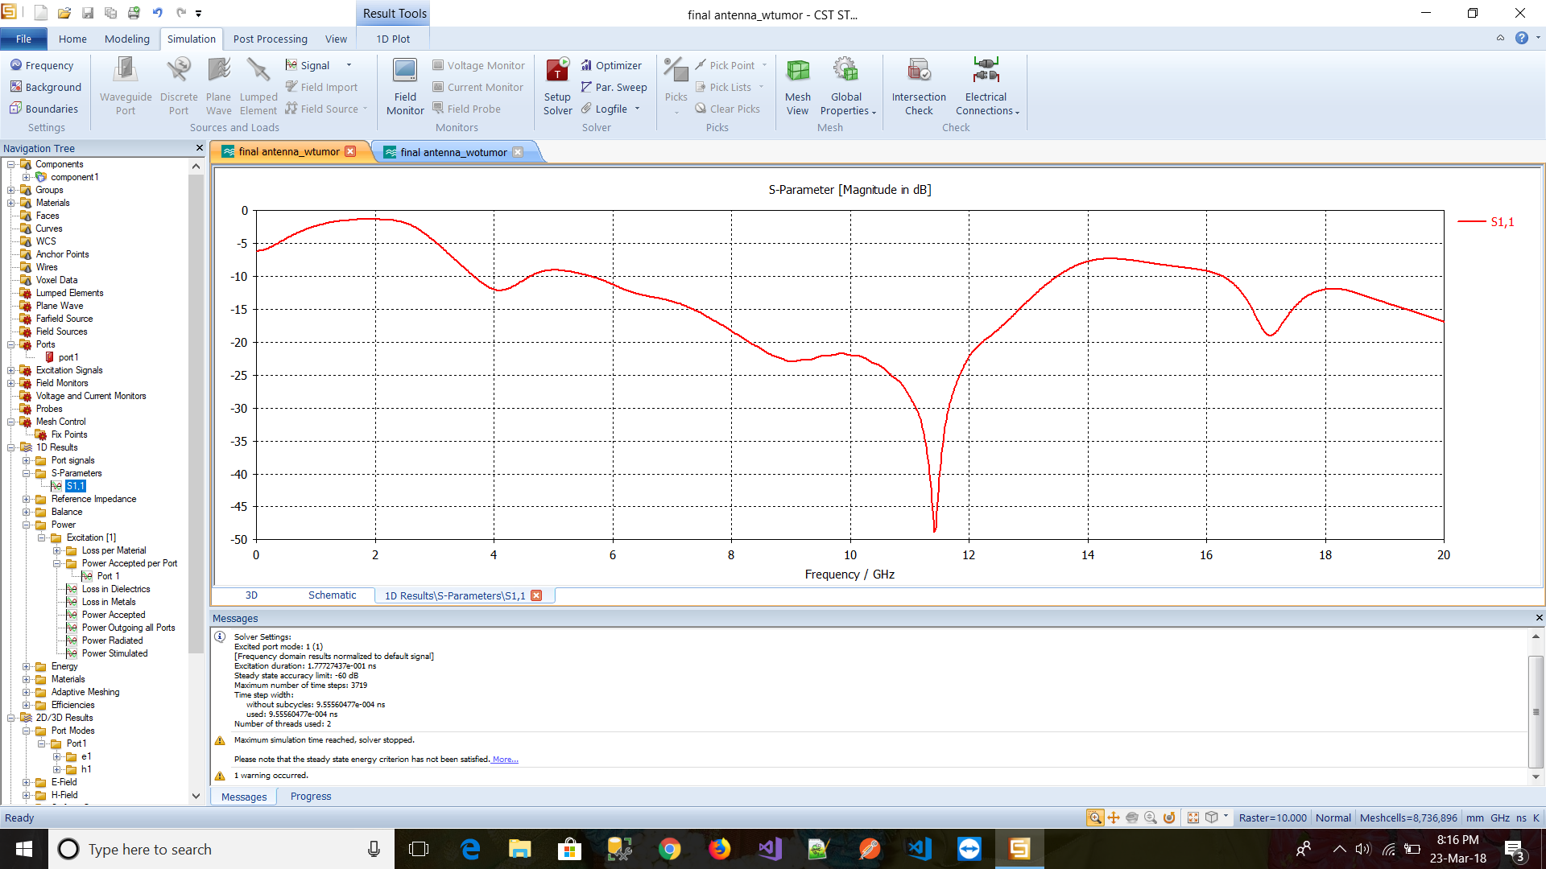
REFLECTION COEFFICIENT S11 OF HEAD MODEL WITH TUMOR
The reflection coefficient S11 of the head model with tumour.

Slide 31
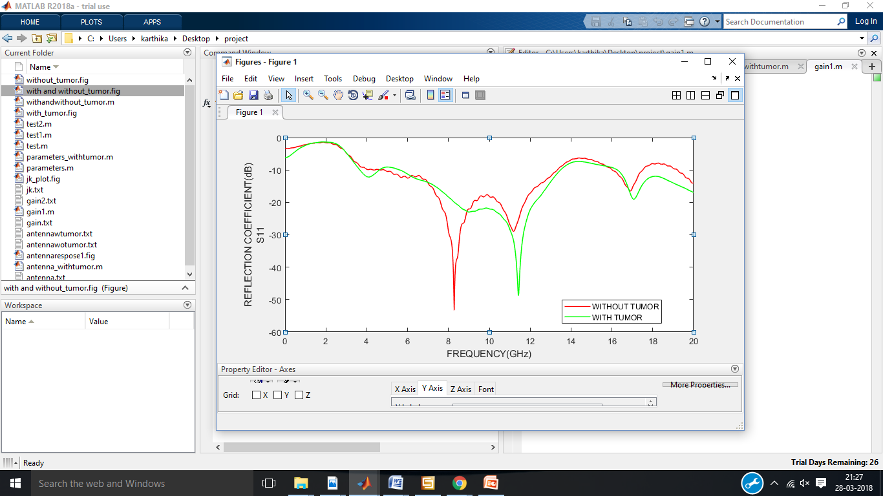
Both the S11 values of the head phantom model with and without tumour were obtained.
Both these values were plotted as the single graph which shows the phase shift between them.

Slide 32
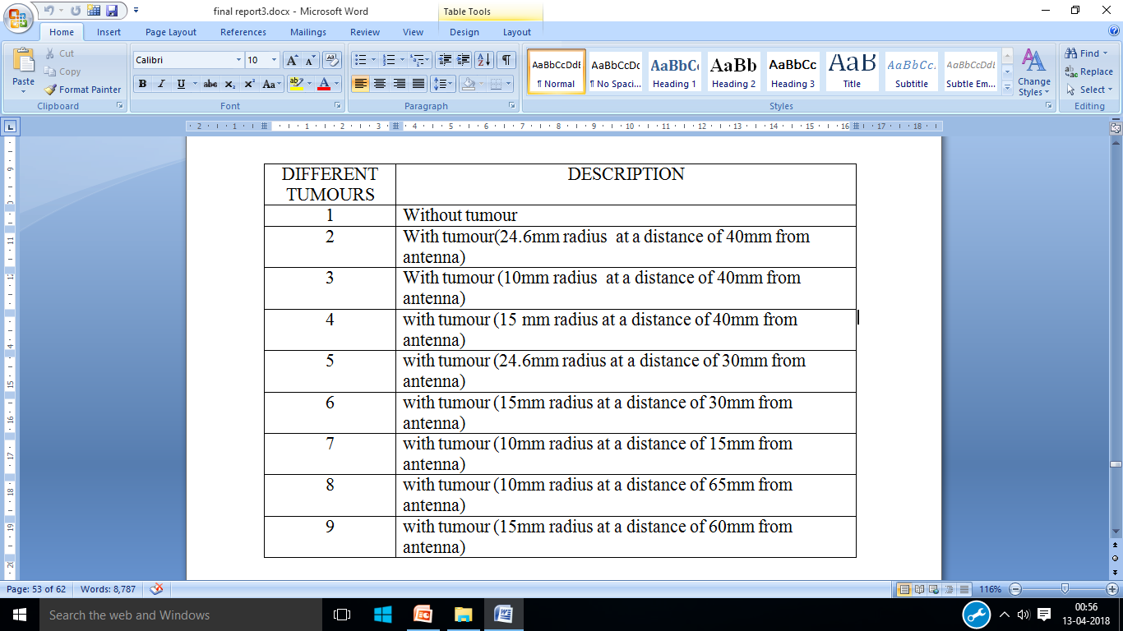
STATISTICAL ANALYSIS

Slide 33
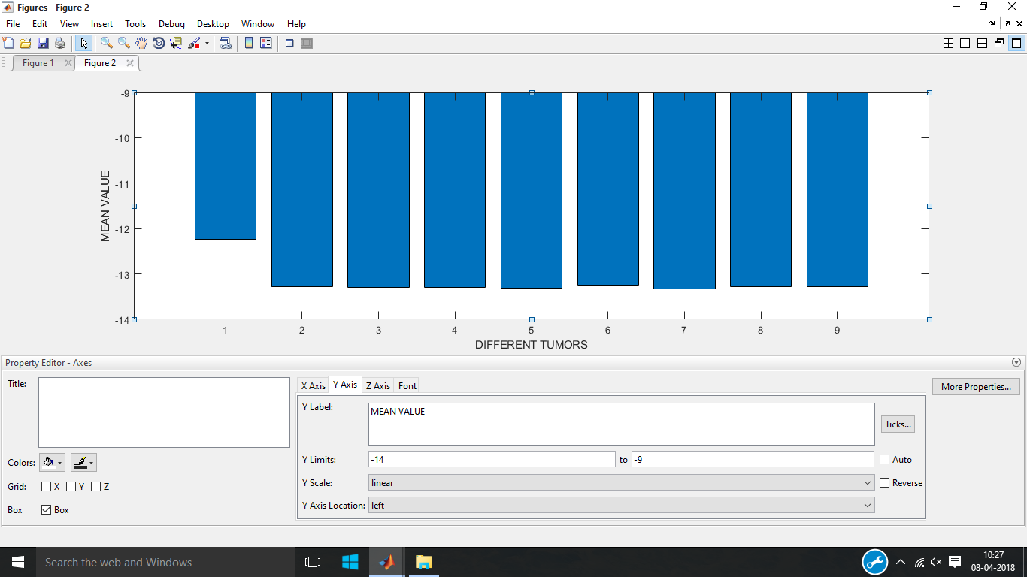
MEAN
The statistical mean refers to the mean or average that is used to derive the central tendency of the data. It is determined by adding all the data points in a population and then dividing the total by the number of points.

Slide 34
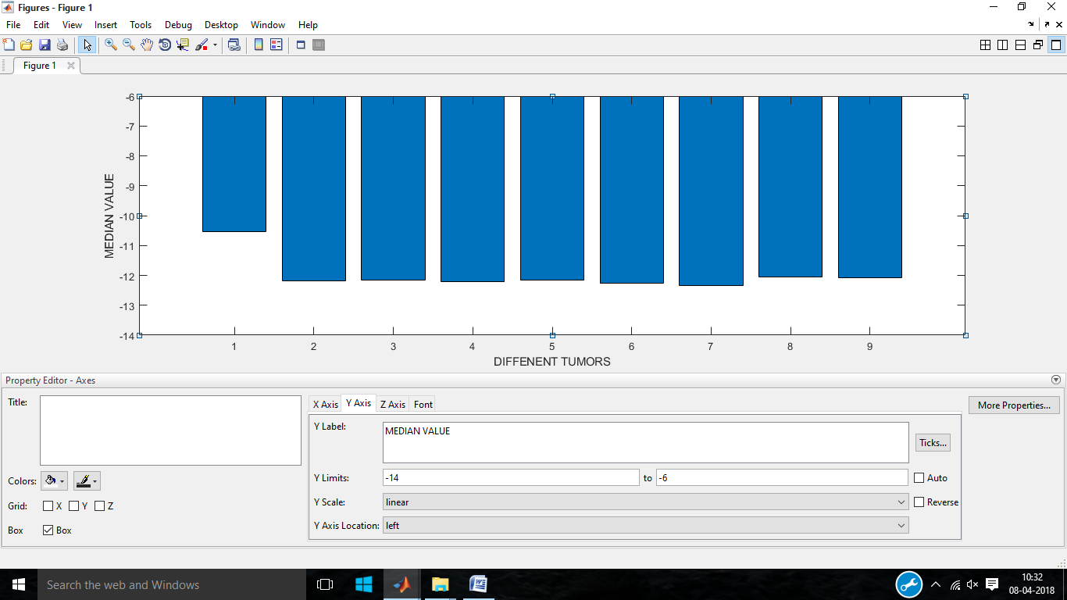
MEDIAN
The median is a simple measure of central tendency. To find the median, we arrange the observations in order from smallest to largest value. If there are an odd number of observations, the median is the middle value. If there is an even number of observations, the median is the average of the two middle values.

Slide 35
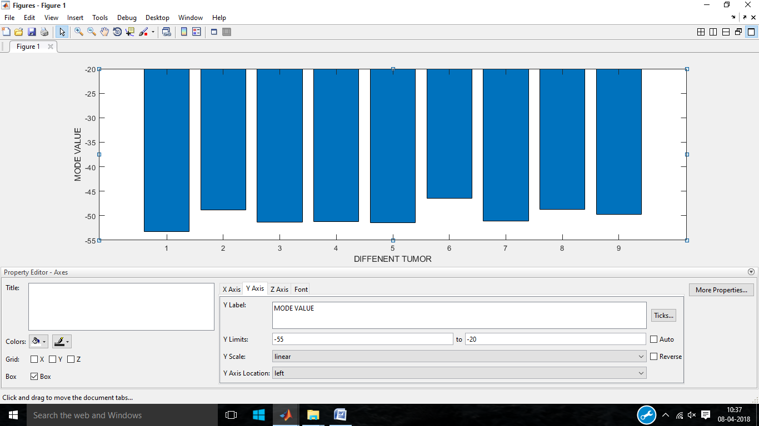
MODE
The mode is a statistical term that refers to the most frequently occurring number found in a set of numbers. The mode is found by collecting and organizing data in order to count the frequency of each result. The result with the highest number of occurrences is the mode of the set.

Slide 36
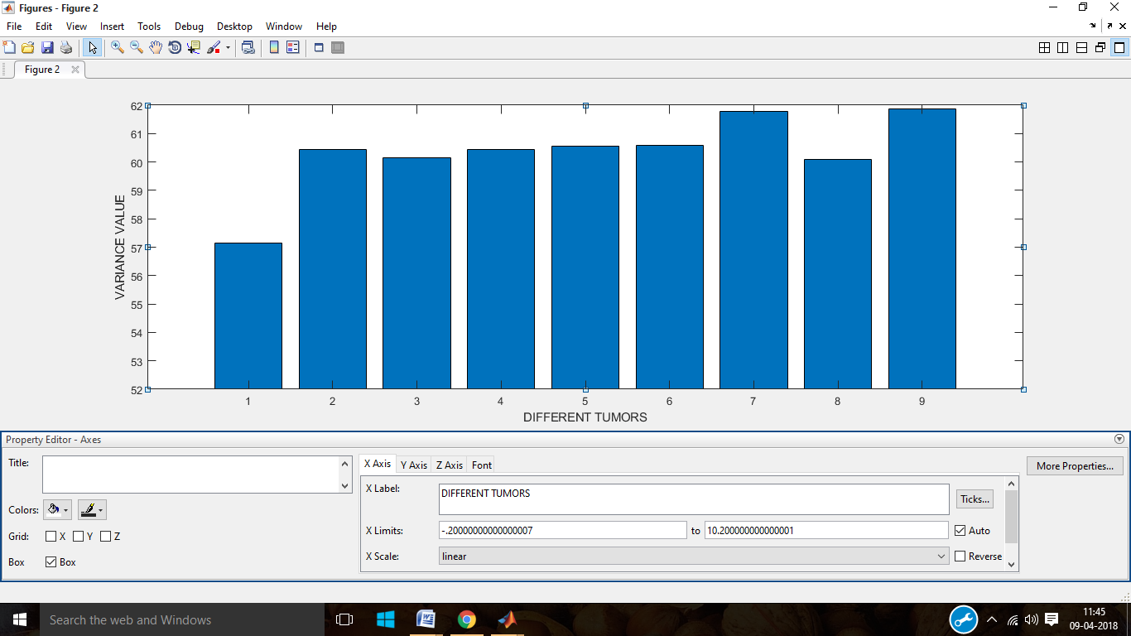
VARIANCE
The variance measures how spread out a distribution is. In other words, they are measures of variability. The variance is computed as the average squared deviation of each number from its mean.

Slide 37
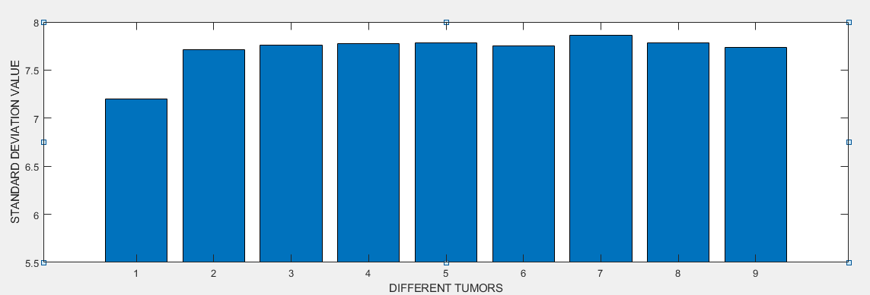
STANDARD DEVIATION
In statistics, the standard deviation is a measure that is used to quantify the amount of variation or dispersion of a set of data values.

Slide 38
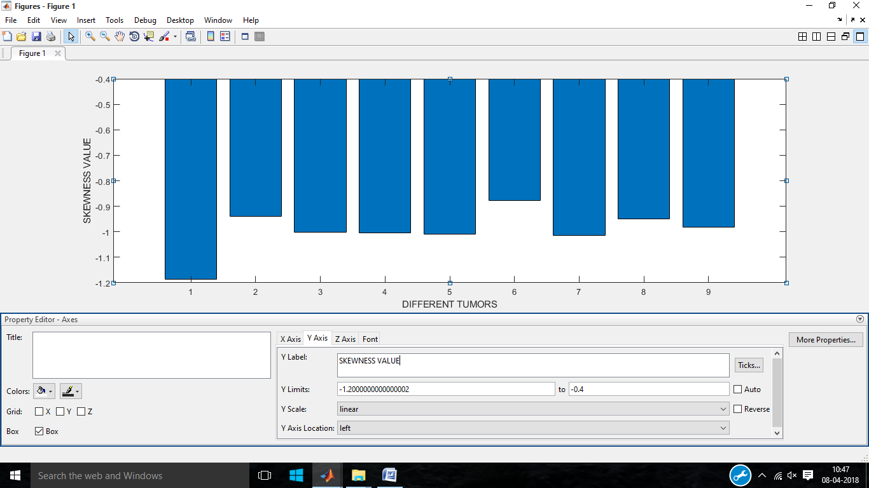
SKEWNESS
Skewness is asymmetry in a statistical distribution, in which the curve appears distorted or skewed either to the left or to the right. Skewness can be quantified to define the extent to which a distribution differs from a normal distribution.

Slide 39
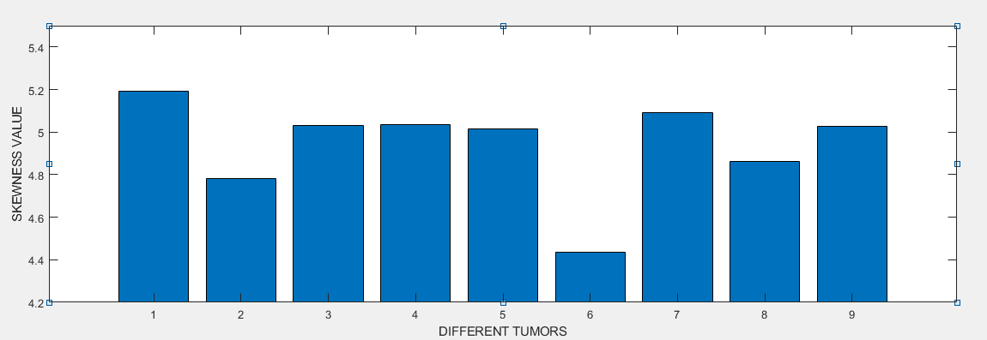
KURTOSIS
Kurtosis is a measure of the sharpness of the peak of the frequency distribution curve.

Slide 40
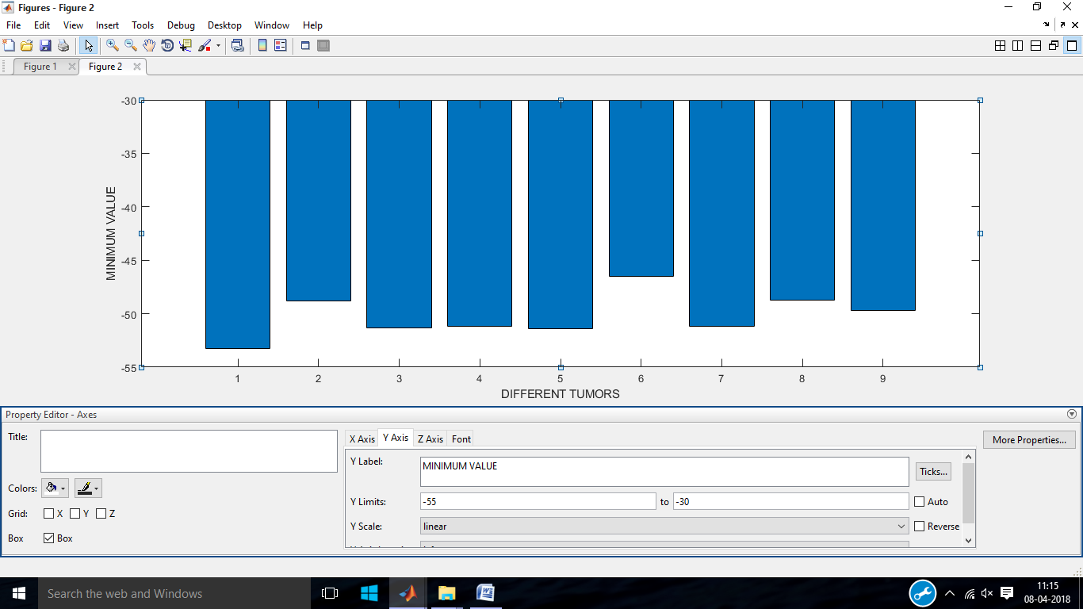
MINIMUM VALUE
The minimum value is the smallest value in the data set.

Slide 41
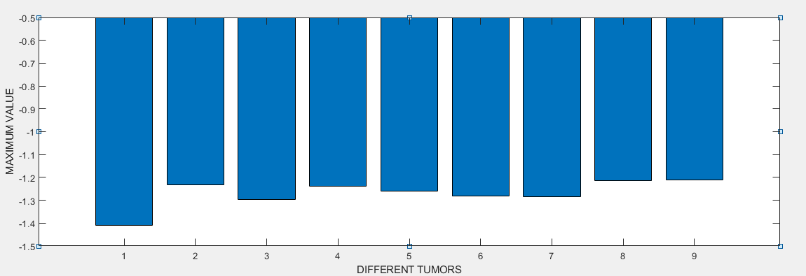
MAXIMUM VALUE
The maximum value is the largest value in the data set.

Slide 42
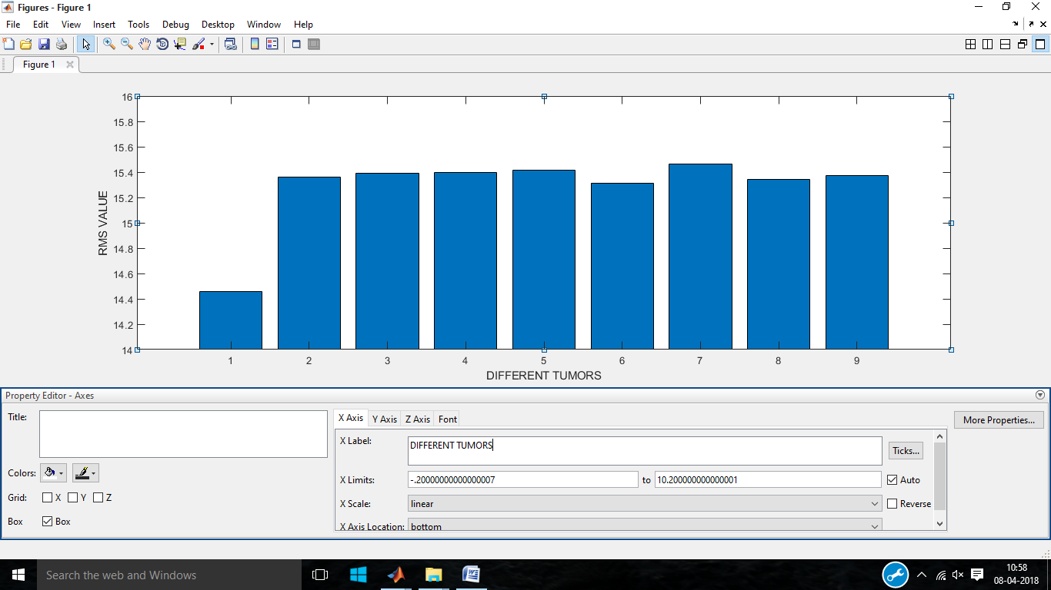
RMS
The RMS value of a set of values is the square root of the arithmetic mean of the squares of the values, or the square of the function that defines the continuous waveform.

Slide 43
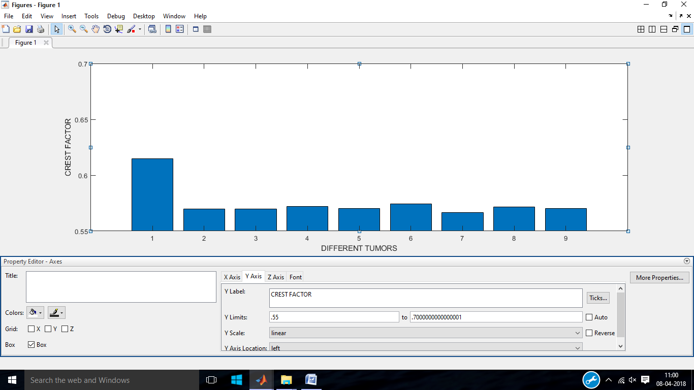
CREST FACTOR
Crest factor is usually expressed in decibels, so it's defined as the level difference between the RMS and the peak value of the waveform.

Slide 44
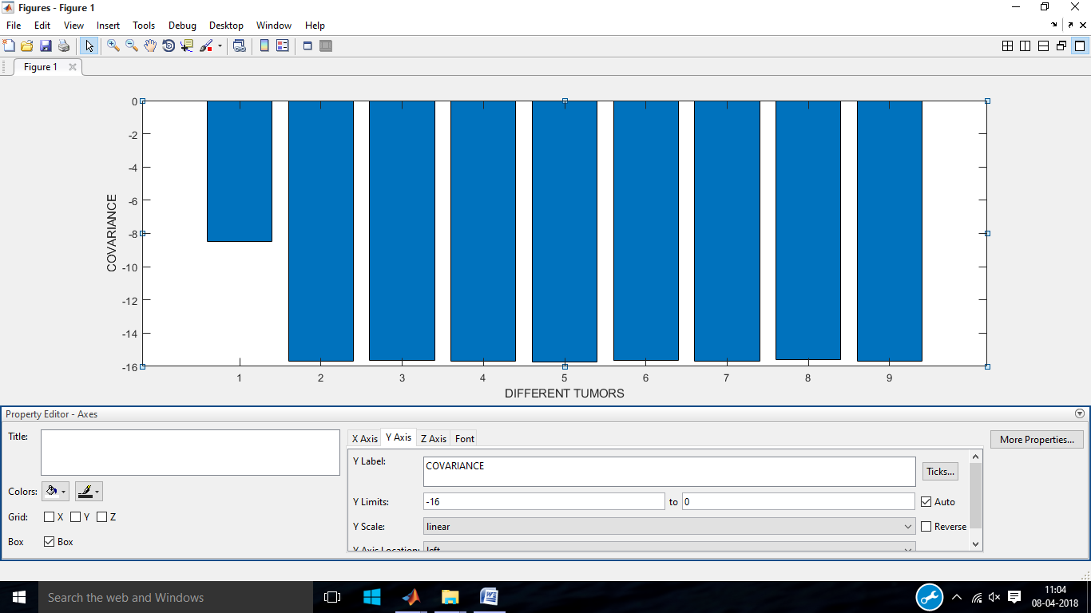
COVARIANCE
Covariance is a measure of how changes in one variable are associated with changes in a second variable.

Slide 45
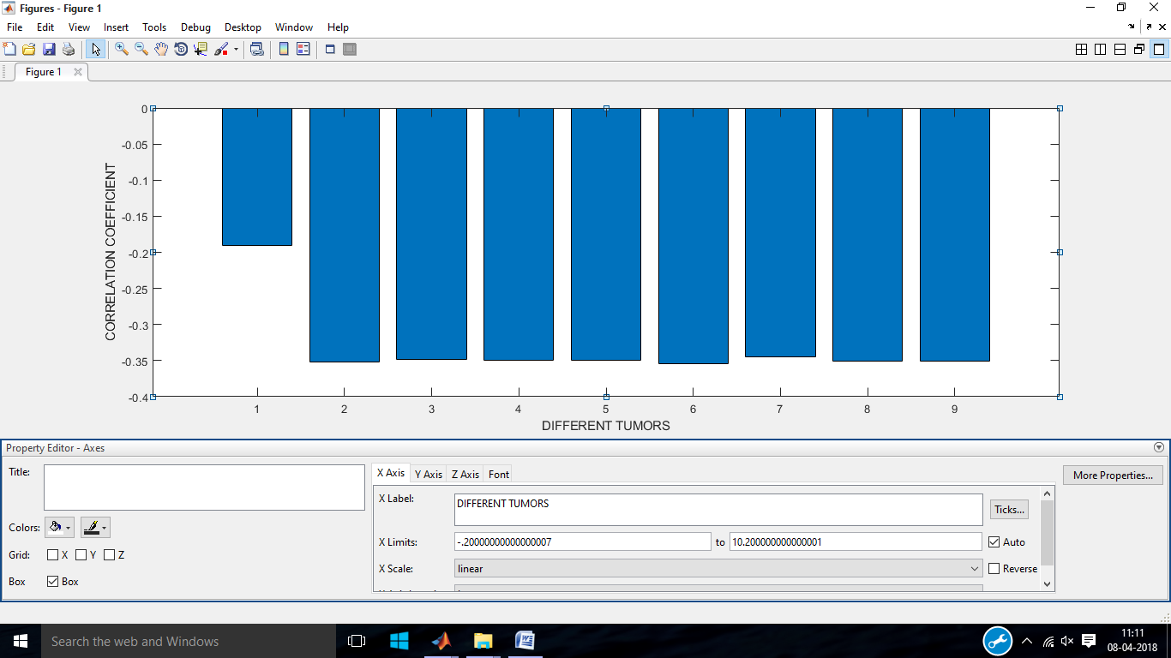
CORRELATION COEFFICIENT
The correlation coefficient measures the strength and direction of a linear relationship between two variables on a scatter plot.

Slide 46
TOOLS REQUIRED
CST Microwave Studio
MATLAB

Slide 47
CONCLUSION
We designed and simulated an UWB pentagon antenna with little modifications in patch and ground in order to improve the bandwidth and directivity and it is fabricated on FR-4 substrate.
The human head phantom designed with and without tumour was tested with the designed antenna.
The various response (with and without tumour) observed by the antenna were analysed using MATLAB.
From the response of simulated reflection coefficient we found the statistical differences between the normal head and tumorous head.

Slide 48
FUTURE WORK
The future work of our project is to find the accurate position and size of tumour. By using different material as substrate the gain, return loss, directivity can be further increased in order to analyse very minute sized tumours.

Slide 49
REFERENCES
Eng. M. A. Shokry, Prof. Dr. A. M. M. A. Allam “UWB Antenna for Brain stroke and Brain Tumour Detection“ Faculty of Information Engineering and Technology German University in Cairo Cairo,Egypt, 2016.
Adhitya Satria Pratama, Muhammad Firdaus S. Lubis, Fitri Yuli Zulkifli, Eko Tjipto Rahardjo” A UWB Antenna for Microwave Brain Imaging” Universitas Indonesia Kampus UI Depok, West Java, Indonesia, 2015.
Mohammed A. Alzabidi, Maged Aldhaeebi and Ibrahim Elshafiey “Optimization of UWB Vivaldi Antenna for Tumor Detection“ Department of Electrical Engineering King Saud University Riyadh, Saudi Arabia,2013.
Haoyu Zhang, Brian Flynn, Ahmet T. Erdogan, Tughrul Arslan” Microwave Imaging for Brain Tumour Detection Using an UWB Vivaldi Antenna Array” Advanced Smart Antenna Technologies Research Group, School of Engineering, The University of Edinburgh, EH9 3JL, UK, 12-13 November 2012.
Haoyu Zhang, Ahmed O. El-Rayis, Nakul Haridas, Nurul H. Noordin, Ahmet T. Erdogan, Tughrul Arslan “A Smart Antenna Array for Brain Cancer Detection” Advanced Smart Antenna Technologies Research Group, School of Engineering, The University of Edinburgh, EH9 3JL, UK, 2011

Slide 50
THANK YOU…

